Slide 1

Big Data Analysis
TITLE: Data science bookcamp case study 3
Meriem Nour Ziari
Rayane Souaker
Maedinne Soualhi

Slide 2
Data science bookcamp case study 3
For clustering data into groups based on geographic location, a key challenge is developing methods that can handle large datasets with complex geographic data. This includes addressing issues such as data sparsity, data inconsistencies, and data errors, which can have a significant impact on the accuracy and usefulness of the resulting clusters. Additionally, there is a need for techniques that can effectively visualize and interpret the clusters to support decision-making processes.
For geographic location visualization and analysis, a major challenge is selecting appropriate visualization techniques that can accurately represent the data and communicate meaningful insights to end-users. This involves considering factors such as the scale and scope of the data, the spatial relationships between data points, and the audience's background knowledge and expertise. Additionally, there is a need for methods that can analyze and interpret the geographic data to identify patterns and trends, as well as support informed decision-making

Slide 3
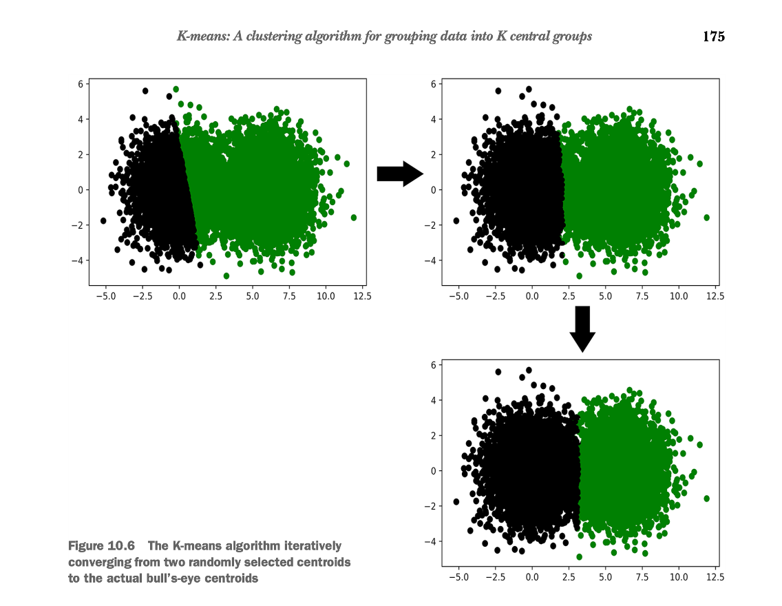
Clustering data into groups

Slide 4
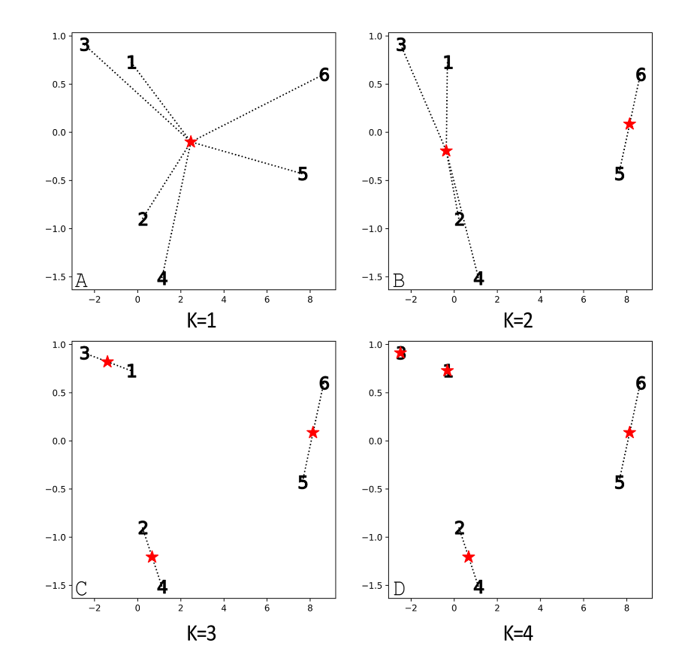
Clustering data into groups

Slide 5
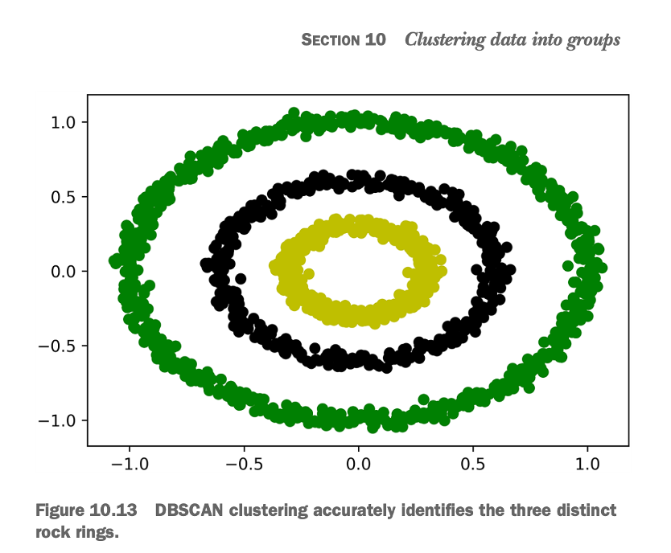
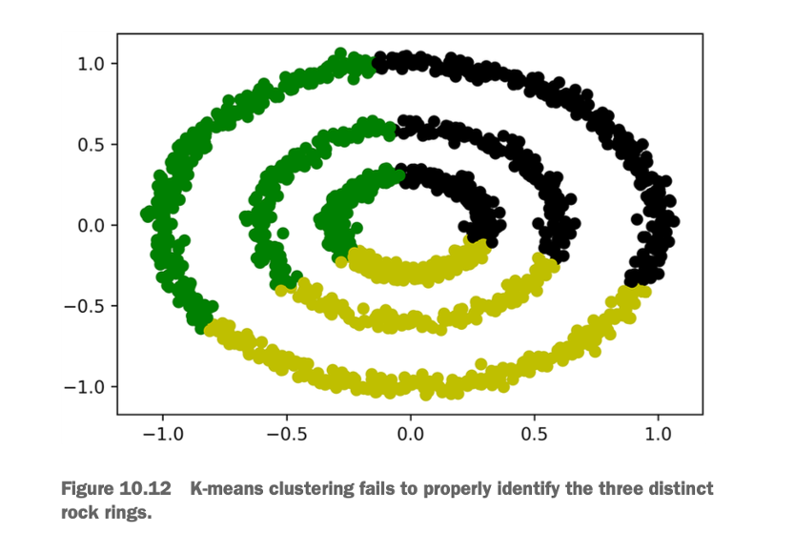
Clustering data into groups

Slide 6
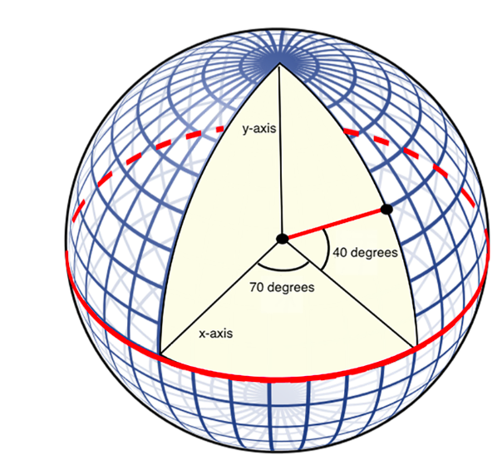
Geographic location visualization and analysis

Slide 7
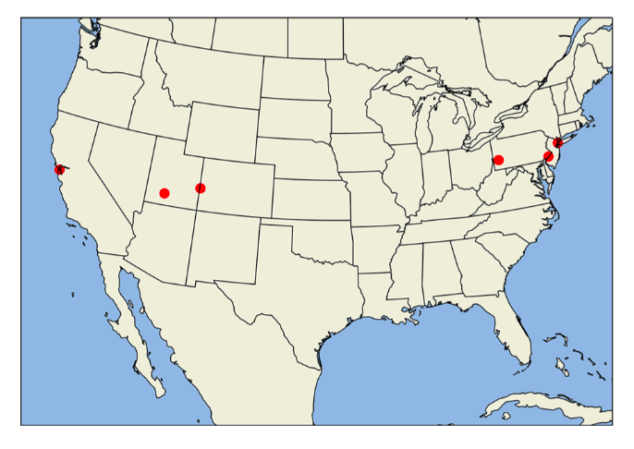
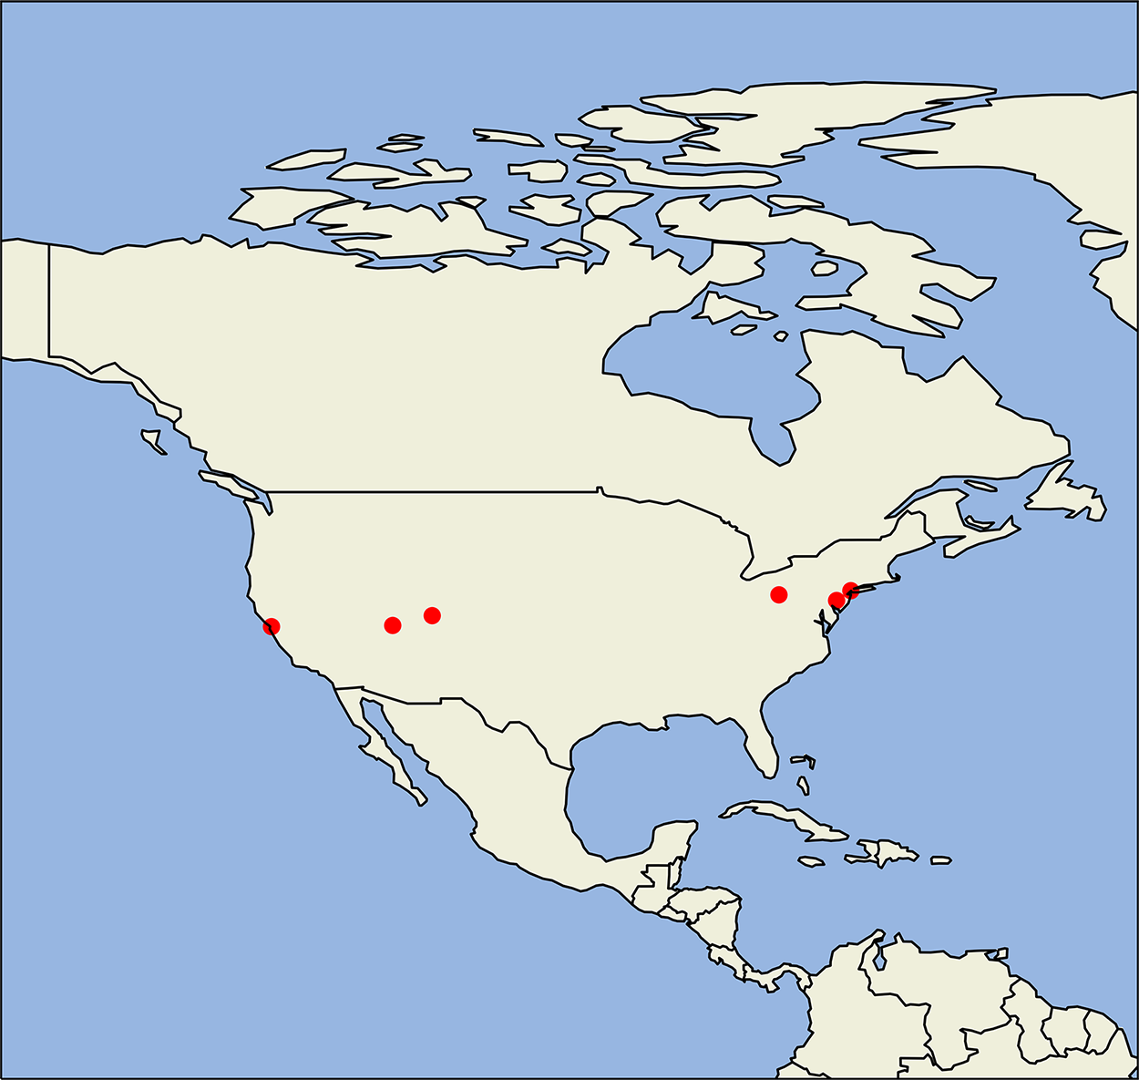
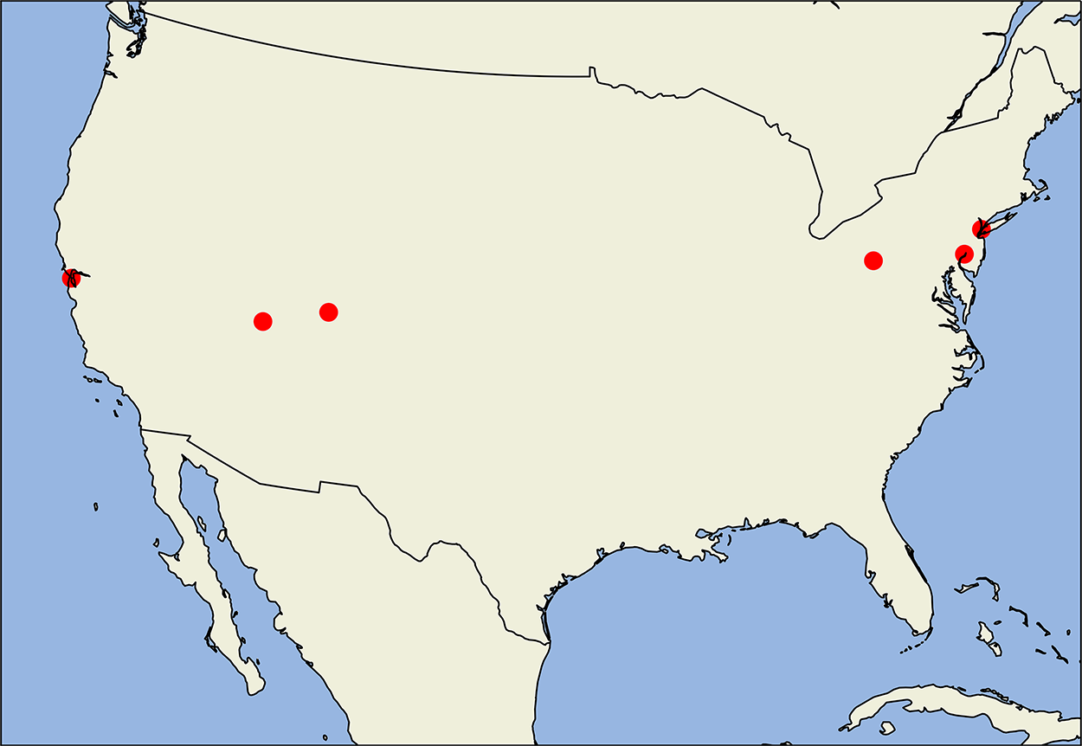
Geographic location visualization and analysis

Slide 8
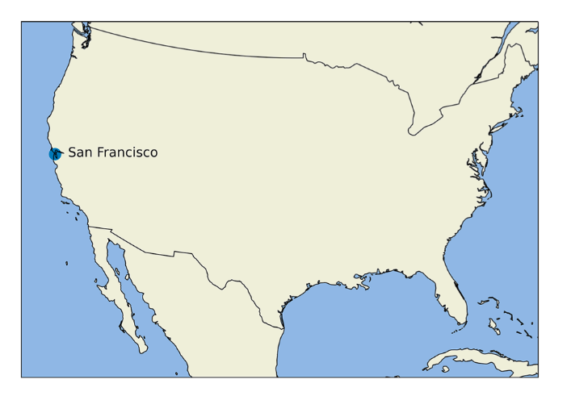
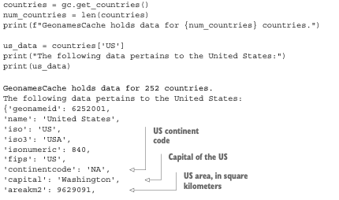
Geographic location visualization and analysis

Slide 9
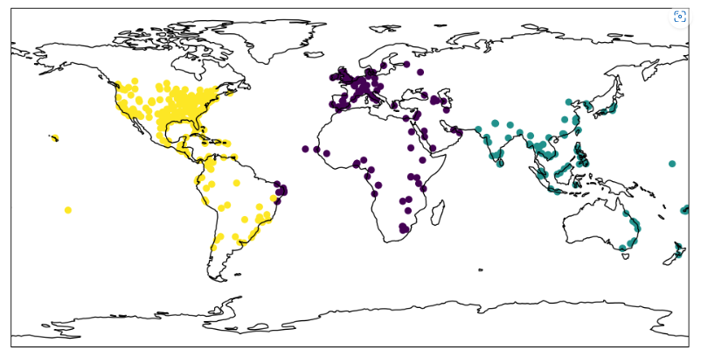
II. Solution of the Case Study
K Means (3) - not helpful
def plot_clusters(clusters, longitudes, latitudes):
plt.figure(figsize=(12, 10))
ax = plt.axes(projection=PlateCarree())
ax.coastlines()
ax.scatter(longitudes, latitudes, c=clusters)
ax.set_global()
plt.show()
df['Cluster'] = KMeans(3).fit_predict(coordinates)
plot_clusters(df.Cluster, df.Longitude, df.Latitude)

Slide 10
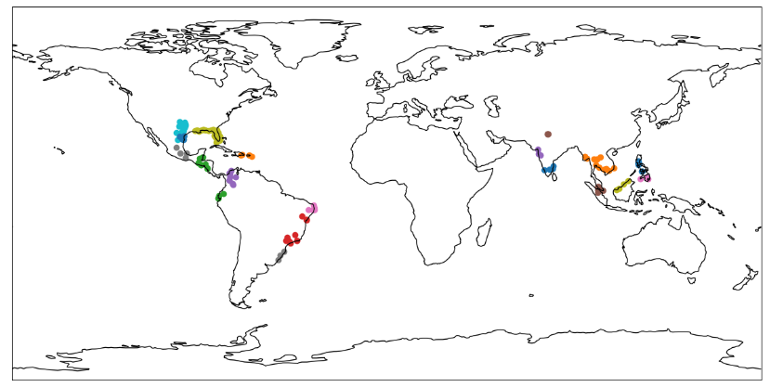
II. Solution of the Case Study : Zika Virus.
Zika
Zika
Zika
Zika
Zika
Zika
Zika
Zika
Zika
Zika
Zika
Zika
Zika
Zika
Zika
Zika

Slide 11
CONCLUSION OF THE CASE STUDY 3
To conclure To calculate the shortest travel distance between two points on the Earth's surface, we can use the great-circle distance, which involves a series of trigonometric operations. The latitude and longitude coordinates of a point on the Earth's surface can be measured in terms of its angular position relative to the x-axis and y-axis.
Using the Cartopy library, we can visualize these coordinates on a map with various projection types depending on the geographical scope of the data. The GeoNamesCache library enables us to obtain latitudes and longitudes for location names, and it maps city names to their corresponding geographic coordinates. However, there may be multiple cities with the same name, and GeoNamesCache can map multiple coordinates to a single city name. In this case, it is advisable to return the coordinates of the most populous city with that name. While averaging the latitudes and longitudes of a country's cities can give an approximation of its central coordinates, it may not be entirely accurate due to city bias and the curved shape of the Earth.

